Slide 2
Don't use slang or colloquial expressions.
Example: The little kids who go to the local day care center are totally cool to be around. It's awesome to see how things that would seem gross or weird to guys in the dorm seem perfectly okay to them.
little kids
totally cool
Awesome
gross or weird
guys
okay

Slide 3
In college writing,
"little kids" are "children;“
"totally cool" may be "interesting," or "fascinating";
nothing is -"awesome," "gross," or "weird." "Guys" might be "students" and
"perfectly okay" may be “acceptable”.
Your readers will expect that your speech and written work will be on a higher level than informal conversations with friends

Slide 4

Informative Speech

Slide 5
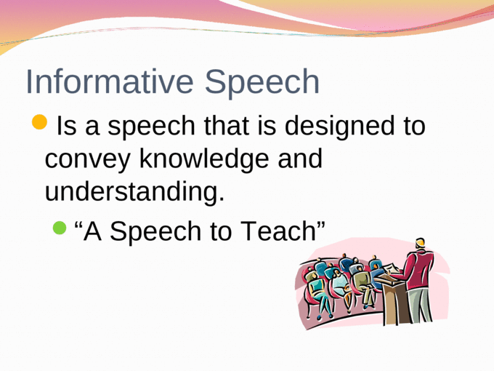

Slide 6
Characteristics of Effective Informative Speaking
1. Intellectually Stimulating-
2. Relevant-
3. Creative-
4. Memorable-
5. Address different learning styles:

Slide 7
1. Intellectually Stimulating-
New information or information that is explained in a way that piques audience members’ interest.

Slide 8
Intellectually Stimulating
Your audience will perceive information to be intellectually stimulating when
it is new to them and
when it is explained in a way that grabs their curiosity and excites their interest.
By new information, we mean information that most of your audience is unfamiliar with or new insights into a topic with which they are already familiar.

Slide 9
If your audience is unfamiliar with your topic, you should consider how you might tap the members’ natural curiosity

Slide 10
INTELLECTUALLY STIMULATING
If your audience members are familiar with your topic, you will need to
identify information that will be new to them. Begin by asking yourself,
------What about my topic do listeners probably not know?
Then consider how deep you will go and breadth as you answer the question.

Slide 11
Depth has to do with going into more detail than people’s general knowledge of the topic
Breadth has to do with how your topic relates to associated topics.
When your topic is one that audience members are familiar with, you will need to explore a new angle on it if you are going to stimulate them intellectually.

Slide 12
2. Relevant-
Make sure your audience knows how the information you share is relevant to them.
Do this with each main point..

Slide 13
Relevant Presenter
General rule to remember when preparing your informative speeches is this:
Don’t assume your listeners will recognize how the information you share is relevant to them.

Slide 14
Some useful tips:
Incorporate listener relevance links, statements that clarify how a particular point may be important to a listener, throughout the speech.
As you prepare each main point, ask yourself, How would knowing this information make my listeners happier, healthier, wealthier, and so forth?
Or you can compare unfamiliar aspects of your topic to something your listeners are likely to be familiar with.

Slide 15
3. Creative-
Your speech should contain different or original ideas.
Good research will aid in this.

Slide 16
Creative
Your audience will perceive your information to be creative when it yields different or original ideas and insights.
You may never have considered yourself to be creative, but that may be because you have never worked to develop innovative ideas.
Contrary to what you may think, creativity is not a gift that some have and some don’t; rather, it is the result of hard work

Slide 17
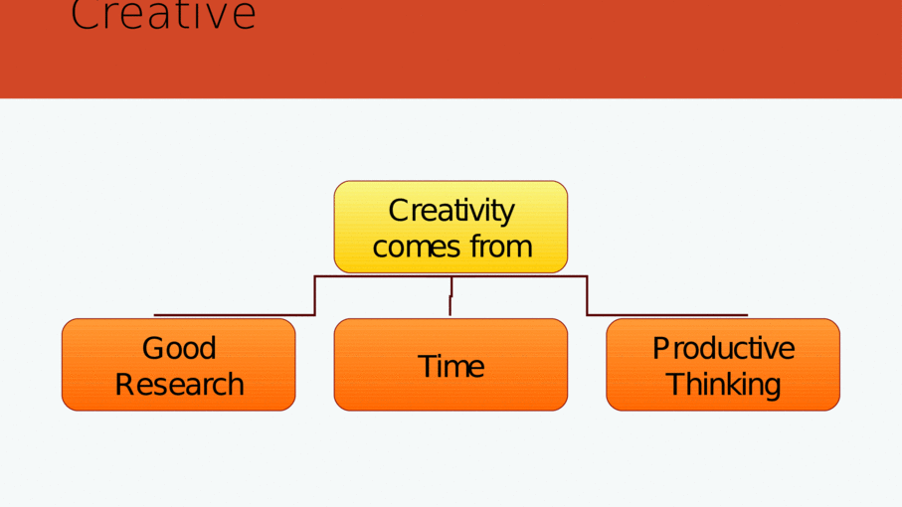

Slide 18
Creative
Creative formative speeches begin with good research.
The more you learn about the topic, the more you will have to think about and the more you will be able to develop it creatively.
Speakers who present information creatively have given them-selves lots of supporting material to work with.

Slide 19
For the creative process to work, you have to give yourself time
Rarely do creative ideas come just before a deadline.
Instead, they are likely to come when we least expect them, when we’re driving our car, preparing for bed, daydreaming, or saying your prayers.
The creative process depends on having time to mull over ideas.
If you complete a draft of your outline several days before you speak, you’ll have time to consider how to present your ideas creatively

Slide 20
Creative
For the creative process to work, you have to think productively.
Productive thinking occurs when we contemplate something from a variety of perspectives. Then, with numerous ideas to choose from, we can select the ones that are best suited to our particular audience.

Slide 21
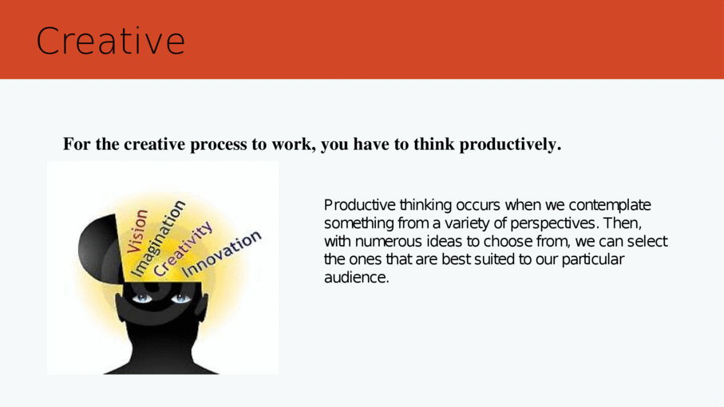

Slide 22
4. Memorable-
A lot of information will be given in an informative speech.
Emphasize your specific goal and main points.
Make them remember you and what you have said!
By using Presentational aids, repetition, transitions, humor and other emotional anecdotes, and mnemonics and acronyms.

Slide 23
Memorable
If your speech is really informative, your audience will hear a lot of new information but will need your help in remembering the most important.
Emphasizing your specific goal and making sure your main points are stated in parallel language.

Slide 24
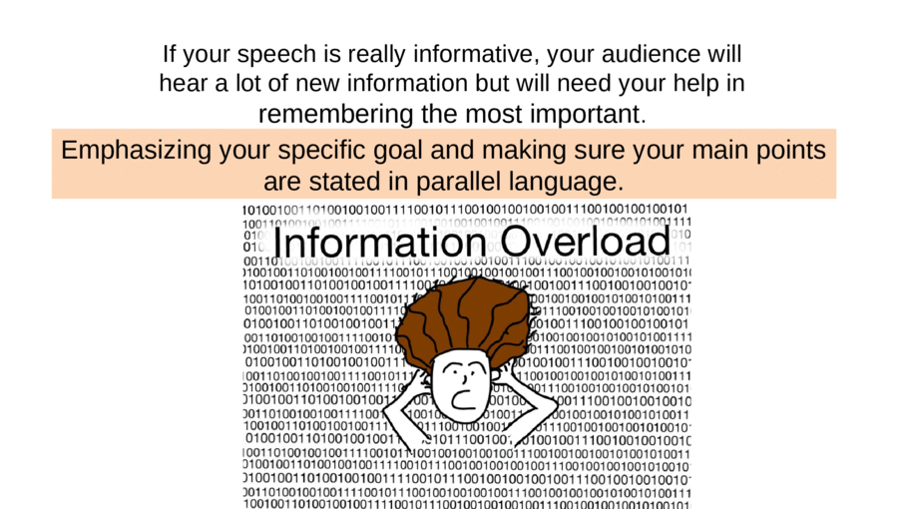

Slide 25
. Techniques for making informative speech material memorable
• Presentational aids
• Repetition
• Transitions
• Humor and other emotional anecdotes
• Mnemonics and acronyms

Slide 26
Presentational aids
16. Presentational aids provide audience members with a visual or auditory memory of important or difficult material process of making wine

Slide 27
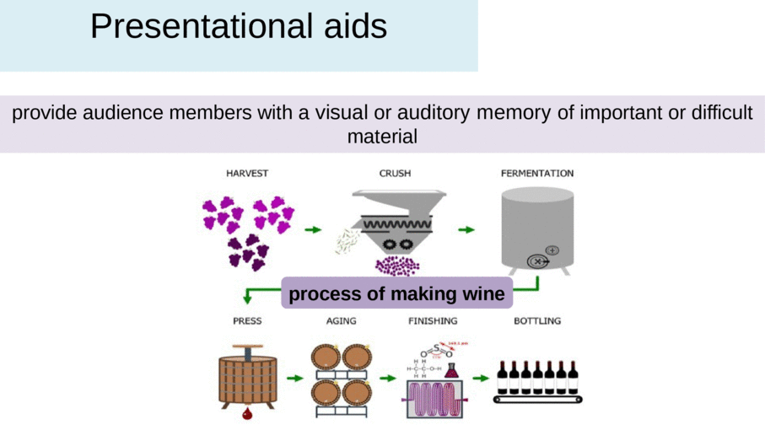

Slide 28
Repetition
I have but one lamp by which my feet are guided; and that is the lamp of experience.
I know of no way of judging of the future but by the past. And judging by the past, I wish to know what there has been in the conduct of the British ministry for the last ten years....
...if we wish to be free--if we mean to preserve invioate those inestimable privileges...if we mean not basely to abandon the noble struggle....we must fight! I repeat it, sir, we must fight!

Slide 29
Transitions in a speech-example
Let’s talk more specifically about how you can contract the disease. (transition from introduction to first main point)
Unlike Sara, you have the ability to prevent bacterial meningitis. (transition into second main point)
So, I encourage you to keep Sara’s story in mind as you make decisions over the next few stressful weeks. (transition into the conclusion)

Slide 30
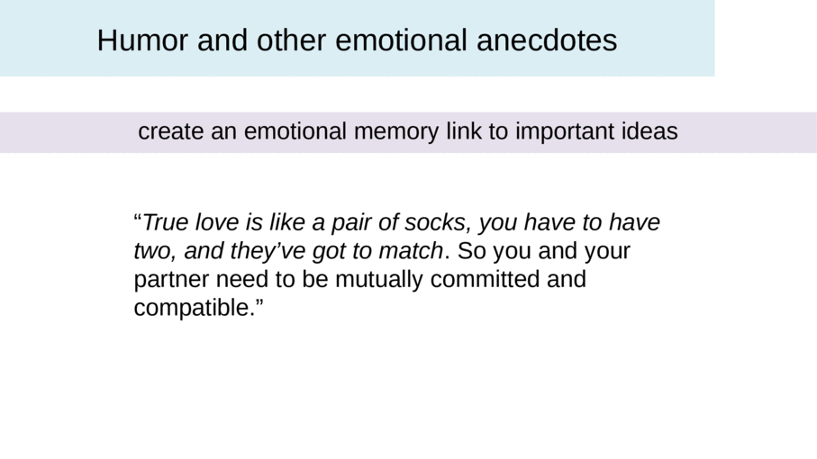

Slide 31
Mnemonics and acronyms
These provide an easy memory prompt for a series or a list
“You can remember the four criteria for evaluating a diamond as the four Cs: carat, clarity, cut, and color.”
“As you can see, useful goals are
SMART: S for specific, M for measurable, A for action-oriented, R or reasonable, and T for time-bound. That’s SMART.”

Slide 32
Demonstration-
Method of informing that shows how something is done, displays the stages of a process, or depicts how something works. Should be very knowledgeable on the topic.

Slide 33
Goals
One of the goals of an informative speech is to enhance the understanding of the audience.
Another goal of an informative speech is to maintain the interest of the audience.
A final goal of an informative speech is for the audience to remember the speech.

Slide 34
An informative speech aims to inform the audience about a specific topic.
A persuasive speech aims to persuade the audience to perform a certain action or convince the audience to adopt the belief or opinion of the speaker.
Many speeches will combine features of informative and persuasive speeches.

Slide 35
Know the audience: the types of knowledge they possess, the core beliefs they hold, and what motivates them to undertake actions.
Considering the purpose of the speech will help determine if the speech should use more of the features of informative or persuasive speeches.

Slide 36
Common Informative Patterns
Process speeches: presents information how something is done , made or occurs
Expository speeches: presents information that provides carefully researched in-depth knowledge about a complex topic.
These include political. Economic, social, religious, or ethical issue; forces of history: a theory, principle , or law and a creative work

Slide 37
5. Address different learning styles:
Feeling- provide concrete, and vivid images, examples, stories..
Watching- visual aids thinking- rhetorical questions, explanations, statistics
Doing- encourage your listeners to do something during or after your speech.

Slide 38
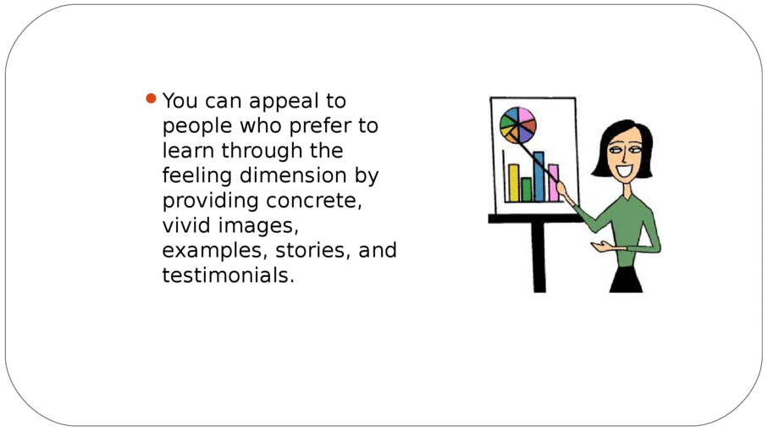

Slide 39
Address Diverse Learning Styles
Because the members of your audience learn differently, you will be most successful at informing all your audience when you present your information in ways that appeal to all styles of learning

Slide 40
Address the watching dimension by using visual aids.
Address the thinking dimension by including definitions, explanations, and statistics.

Slide 41
Address the doing dimension by encouraging your listeners to do something during the speech or afterward.
Rounding the learning cycle in this way ensures that you address the diverse learning style preferences of your audience and make the speech understandable, meaningful, and memorable for all.

Slide 42
Methods of Informing
1. Description- the informative method used to create an accurate, vivid, verbal picture of an object, geographical feature, setting, event, person, or image. (visual aid- or provide vivid descriptions or both)

Slide 43
2. Definition-
Method of informing that explains the meaning of something.
Can be classifying it or differentiating it from similar ideas.
Can define by giving its history or how it came to exist.
Can define by explaining its use or function.
Can define by using a synonym or antonym.

Slide 44
3. Compare or Contrast-
Focuses on how something is similar to and different from other things.
4. Narration-
Recounts an autobiographical or biographical event, myth, story or some other account. Tell the story from beginning to end.

